Slide 1
Isotope Geochemistry
Basic Concepts
Isotopes: Atoms of the same element with the same number of electrons and protons, but whose nuclei contain different numbers of neutrons
They may differ in mass and therefore properties
An element therefore is a mixture of substances with slightly different chemical and physical behaviour
Some isotopes are radioactive (e.g. U, Th), meaning that their nuclei emit radiation; others are stable.
Both are used to gain insights into geochemical processes.

Slide 2
Basic Concepts Cont’d
Kinds of radiation include: alpha, α particles (He nuclei); beta, β particles (electrons) and gamma, γ rays (high energy x-rays)
Nuclei produced by radioactive decay are called daughter products, and are also termed ‘radiogenic’
Radiogenic isotopes find application mainly in:
Dating of rocks, minerals and archaeological artefacts
Tracing geochemical processes e.g. Evolution of the oceans, crust, mantle and atmosphere through geologic time
Tracing sources and paths of dissolved and detrital materials involved in formation of rocks & mineral deposits

Slide 3
Radioactive Decay
Radioactive decay proceeds at a constant rate, unaffected by T, P and chemical combinations in the geologic environment
This means that the proportion of parent atoms disappearing over a given time is constant, thus the rate of decay is:
where λ is the decay constant.
For a number of parent atoms, P = P₀ at time t = 0, it becomes, P = P(t) =
Notes:
Where P is the number of parent atoms remaining at time t, dD/dt is the rate of formation of daughter atoms and λ is the decay constant

Slide 4
The number of daughter atoms produced by time, t is:
At time t, some daughter atoms may have been present, so the total number existing at time t is therefore the original plus those produced by radioactive decay. If the original is D 0 , the total will be D = D₀ + D* = D 0 + P(e^{λt} – 1)
This can be rearranged to:
More easily visualized than the decay constant is a quantity called the half life. This is the time needed for half of a radioactive isotope to decay.

Slide 5

If has decreased to 0.5 in a time t0.5,
1/2P₀ = P₀e^{-λt1/2} , or
Calculating ages using the above equations is based on the following assumptions:
The value of the decay constant has not changed over geologic time; this is sensible since the value is not affected by environmental conditions e.g. T, P.
The rock or mineral has been a closed system since it’s formation. In other words, it has not gained or lost parent or daughter atoms. This assumption may be a bit questionable and variations in calculated ages may be due to it’s failure.

Slide 6
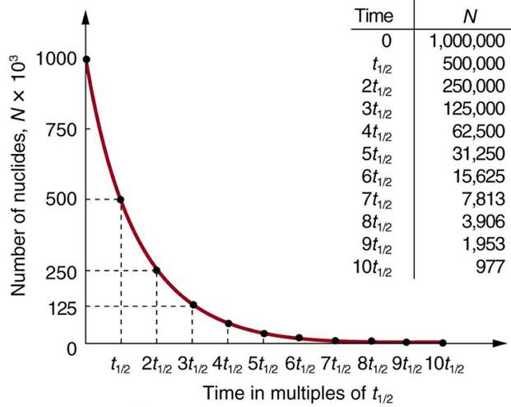
Figure: Parent isotope decay curve, showing the decrease in the number
of parent atoms through ten half-lives (courses.lumenlearning.com)

Slide 7
Stable Isotopes
Large number of stable isotopes occur in nature; modern isotope geochemistry mainly concerned with few light elements- H, C, N, O & S.
Each of these has a lighter, more abundant & one or more heavier, less abundant isotopes; their ratios varying differentially in natural substances.
Characterized by large proportional difference in mass and detectable changes in isotopic ratios may result from ordinary geologic processes.
These variations have provided useful insights into many geologic issues, e.g. formation of minerals and evolution of the earth and biosphere.

Slide 8
Stable isotopes cont’d
The stable isotopes of above elements are useful for interpretation of some geochemical & biological processes because:
the elements are the main components of most minerals, rocks and fluids & basic constituents of life;
mass difference between their heavy & light isotopes is fairly large;
they posses more than one oxidation state e.g. C, N, S & form different kinds of bonds (ionic to highly covalent); and
abundance of the least common isotope sufficiently high to allow for high precision measurements.

Slide 9
Fractionation of stable isotopes
This is the partitioning or distribution of isotopes of an element between two coexisting phases.
Difference in frequencies of vibration of heavy & light isotopes in molecules or crystals leads to fractionation(atoms of light isotopes vibrate at high frequencies relative to those of heavier isotopes).
Fractionation results in redistribution of the isotopes in order to minimize the energy of the system.
Replacement of lighter isotope with a heavier one lowers the vibrational energy of a molecule, making it more stable relative to one containing lighter isotope (e.g. water and water vapour).

Slide 10
Fractionation cont’d
This is also a function of kinetic energy of a molecule, which is dependent on the mass of the molecule (E= ½mv²).
Light molecules (e.g. ¹²C¹⁶O₂ ) can preferentially diffuse out of a system, leaving it enriched in heavier molecules (e.g. ¹²C¹⁸O₂).
In the evaporation of water, the higher translational velocity of lighter ¹H₂¹⁶O molecules allows them to break through the liquid surface preferentially, leading to isotopic fractionation.

Slide 11
Mechanisms of isotopic fractionation
Three (3) mechanisms of stable isotope partitioning have been distinguished:
Mechanisms dependent on physical properties such as evaporation or diffusion e.g. the case of water evaporation;
isotopic exchange reactions resulting in equilibrium between two or more substances e.g. mixing of carbondioxide and water, exchange of the light and heavier oxygen isotopes will occur;
unidirectional reactions such as bacterial reduction of sulfate to sulfide species, which is faster for the light S isotope compared to the heavier one. Concentrates ³²S in sulfide and ³⁴S in the residual sulfate.

Slide 12
Fractionation Factor
The extent of isotopic separation between two coexisting phases A & B is expressed by a ratio called “fractionation factor” α_{A-B, defined as:}
where R is the ratio of the concentration of the heavy to the light isotope (by convention) such as
¹⁸O/¹⁶O, ³⁴S/³²S.
For example, the fractionation factor describing the partitioning of ¹³C & ¹²C between calcite and carbondioxide is expressed as:
.
which has an empirically determined value of 1.0098

Slide 13
Fractionation factor cont’d
Similar α values, very slightly greater or very slightly less than 1 are obtained for other examples of isotope fractionation
Factors influencing the sign and magnitude of separation factors are:
temperature (the basis for stable isotope geothermometry);
chemical composition;
crystal structure and chemical bonds; and
pressure.
Fractionation factors are obtained by:
semi-empirical calculations, using spectroscopic data;
laboratory calibration studies; and
measurements on natural samples whose formation conditions are well known.

Slide 14
The delta (δ) notation
Differences among R numbers are very small and hard to visualize.
Easier to measure the difference in absolute isotope ratios between two substances than the value of R in each of them.
Therefore delta (δ) values normally used to report isotope ratios in units of ppt or per mil (o/oo) relative to a reference standard, example:
where Rsample is ratio of heavy to light isotope in a sample and Rstd is the equivalent in a standard, δX stands for δD, δ¹⁸O, δ³⁴S, Δ¹³C etc.

Slide 15
Delta cont’d
For oxygen isotope ratio in a carbonate sample, this is reported as:
A positive δ value indicates enrichment of the heavier isotope in the sample relative to the standard, whereas as a negative value indicates depletion. For a standard, δX = 0.
Standards include the SMOW(Standard Mean Ocean Water), PDB (Peedee Formation Belemnite), NBS-28 quartz for silicates and NBS-19 for carbonates.

Slide 16
Applications of stable isotope geochem
Stable isotope geochemistry finds application among others, in the following:
geothermometry e.g. using oxygen isotopes;
evaporation & condensation processes;
source of water in hydrothermal processes;
estimation of water/rock ratios;
using sulfur isotopes to explain some sedimentary processess

